Slide 1

IDEATE

Slide 2
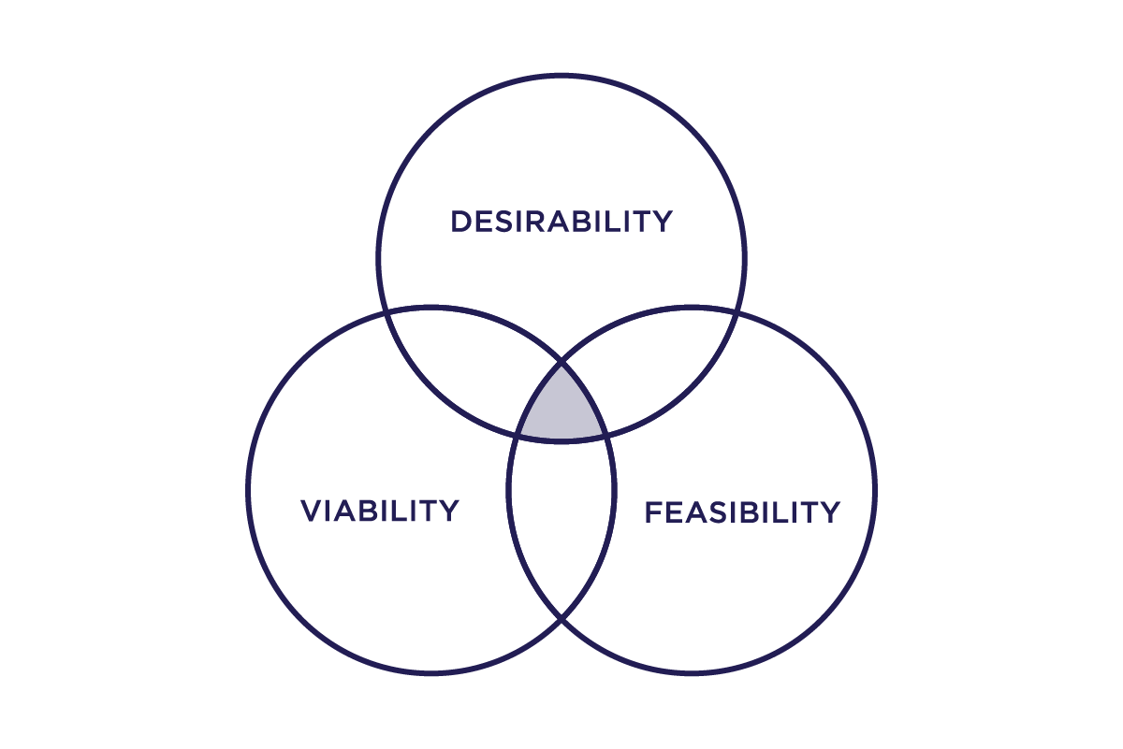
Choosing Solutions
FEASIBILITY - Something functionally possible
VIABILITY - Something economically sustainable
DESIRABILITY - Something people want/need

Slide 3

SELECTED IDEAS
Create and develop a PORTAL “Kyoto Students Portal” targeting new entries which will be facilitated different mental relaxing activities,
Dancing /Singing clubs/Instrument playing1 ( Yanni Music)
Yoga /Meditation & exercises
Art/ Photography clubs/event
Travel hub
Sports club
Mini library facilities
Chatting and hanging out
Food Experimental events
Education/Assignments support system (Senior Based , Senpai-Kohai support system)
Japanese documents translation app ( Well developed app which will delivered important points and actions to take in selected language)
Information app – Provide all the details home appliances , Grocery items , cloths and other necessities( Availability , available places, prices , etc) based on their locations

Slide 4
Thank you

